Slide 1

Scripting Languages
Module 4
Managing Repetition with Loops

Slide 2
Contents
For Loops
C-Style Loops
While Loops
Until Loops
Break and Continue
Nested Loops
Infinite Loops

Slide 3
Learning Objectives
By the end of this Module you should:
Understand and execute scripts that require iteration
Write scripts that iterate through content using a range of loop structures

Slide 4


For Loops

Slide 5
for loops
for is a shell keyword used to control iteration
Iteration allows one or more commands to be executed for each item within a list of items
These items may be contained within a variable, an array or an external file
FOR LOOP BASIC STRUCTURE
for i in items_list; do
command(s) to be executed
for each item
done

Slide 6
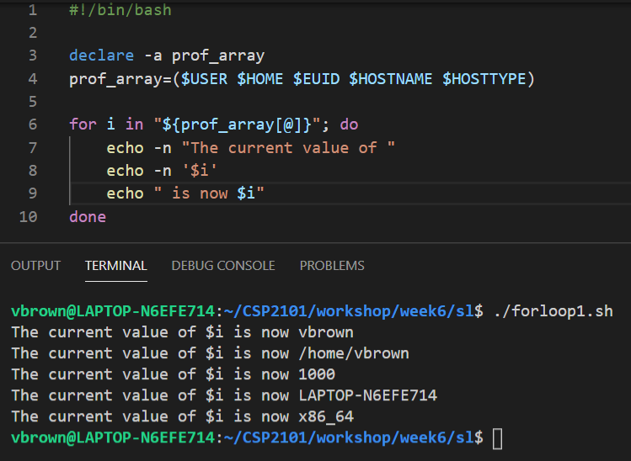
for loop example - array
In a for loop, we read each item in the list from left to right
If the list is a string of text, the items are separated by spaces by default
Each value in the list is assigned to the variable on the left one at a time
~/CSI6203

Slide 7
The IFS
The Internal Field Separator (IFS) variable is used by the system to tell where one item in a list ends and the next one starts
By default, this is a space so that structures such as for loops will count through each word in a list
By setting this to something else, we can make it split each item a list in a different way e.g. newlines (\n)

Slide 8
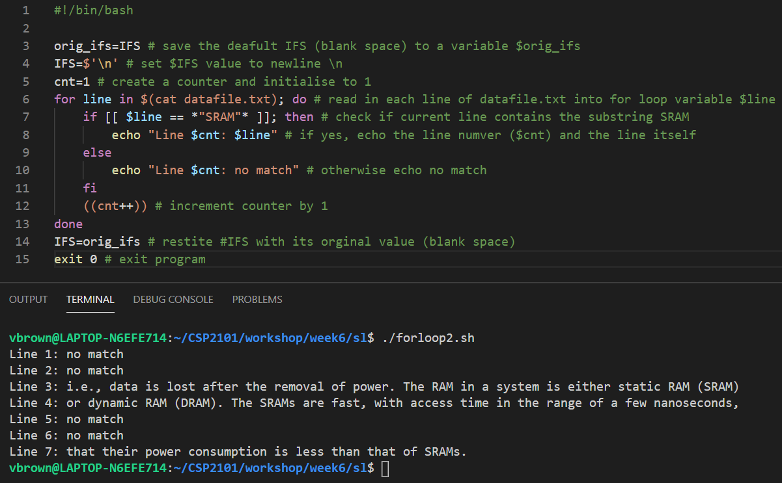
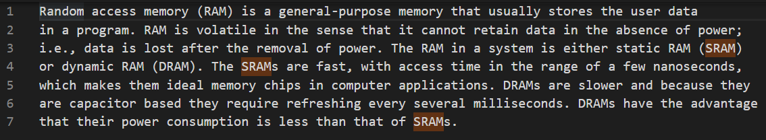
Change IFS value
shell script
datafile.txt
~/CSI6203
output
~/CSI6203

Slide 9
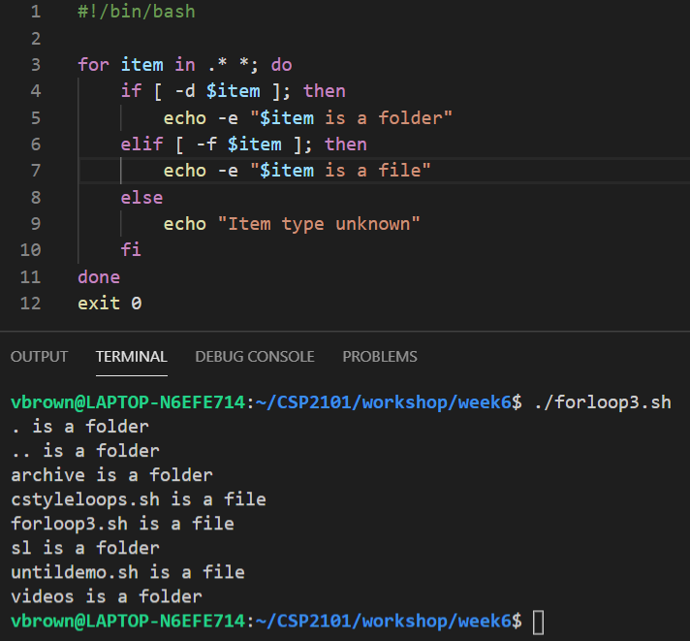
for loops with files directories
For loops are also often used to iterate through the contents of files and directories
If the -d test evaluates to true, then echo that the item is a folder
If the -f test evaluates to true, then echo that the item is a file
If neither the -d or the -f test evaluate true, echo that the item is of an indeterminate type
~/CSI6203

Slide 10
C-Style Loops

Slide 11
C-style for loops
Bash also supports C-style for loops that count a specified number of times
The C-style for loop sets an initial value, a guard and an increment within the loop
This is very similar to for loops in other programming languages such as java, C# and C++
FOR C-STYLE LOOP BASIC STRUCTURE
for (( i=0; i<=x; i++ )); do
command(s) to be executed
for each item/iteration
done
Initialise counter to start point
Set criteria at which loop ends
Set increment criteria

Slide 12
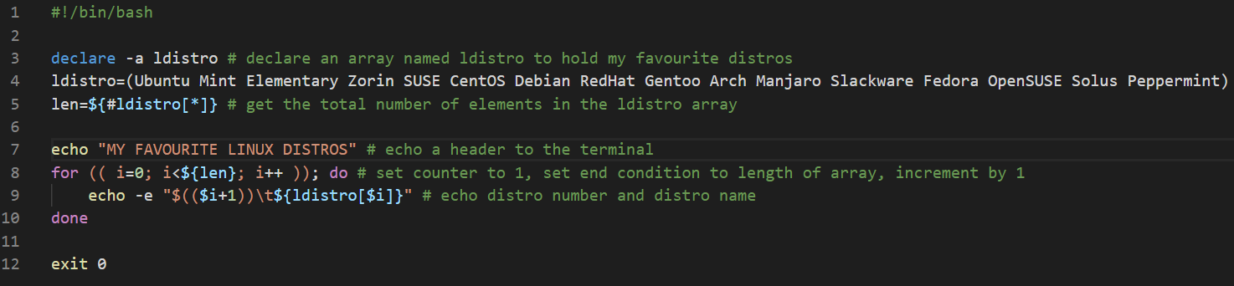
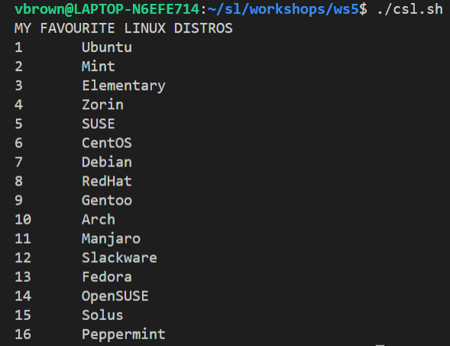
C-style for loops
CODE EXPLAINED:
Declare an array [Line 3]
Populate array with values [Line 4]
Get length of array [Line 5]
Print each array item to terminal with its ordinal positon [Lines 8-10]

Slide 13
While Loops

Slide 14
While loops
For loops are mostly useful when we know exactly how many times we want commands to repeat
In many cases however, we need to keep looping until a certain condition is met, for example:
repeat while the user has not chosen to exit
repeat until a correct value is entered
repeat while there is still additional information being written
This is when while loops come in handy
WHILE LOOP BASIC STRUCTURE
while (( x -gt y )); do
command(s) to be executed
for each item/iteration
done
Loop end criteria

Slide 15
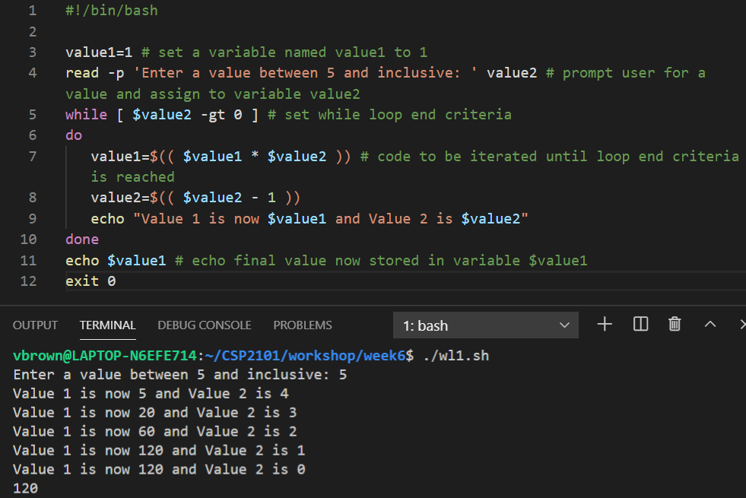
While loop example
~/CSI6203

Slide 16
Until Loops

Slide 17
Until Loops
An until loop is used to execute a given set of commands as long as the given condition evaluates to false
The condition is evaluated before executing the commands
If the condition evaluates to false, commands are executed
Otherwise, if the condition evaluates to true, the loop will be terminated and program control will be passed to whatever code follows
UNTIL LOOP BASIC STRUCTURE
until [ conditional_test ]; do
command(s) to execute if
condition is false
done

Slide 18
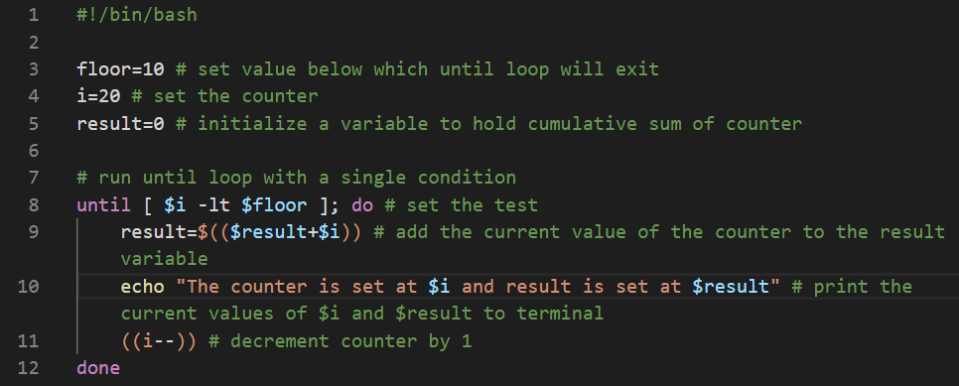
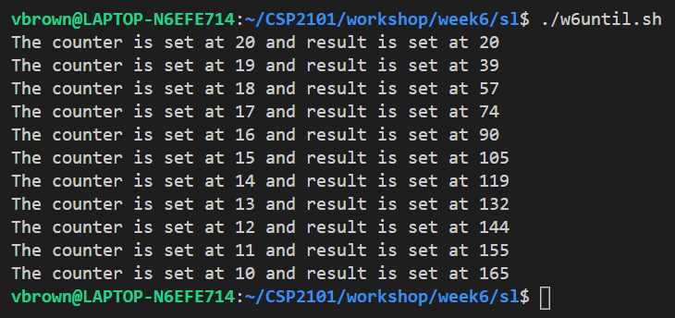
Until Loop Example
~/CSI6203

Slide 19
Break and Continue

Slide 20
Loop Controls – Break and Continue
The loop controls break and continue can be use to change the behaviour of loops
These are primarily useful for error handling or to skip unwanted items
The break statement allows exit from a loop when a condition is met
The continue statement skips the current iteration and moves on to the next one

Slide 21
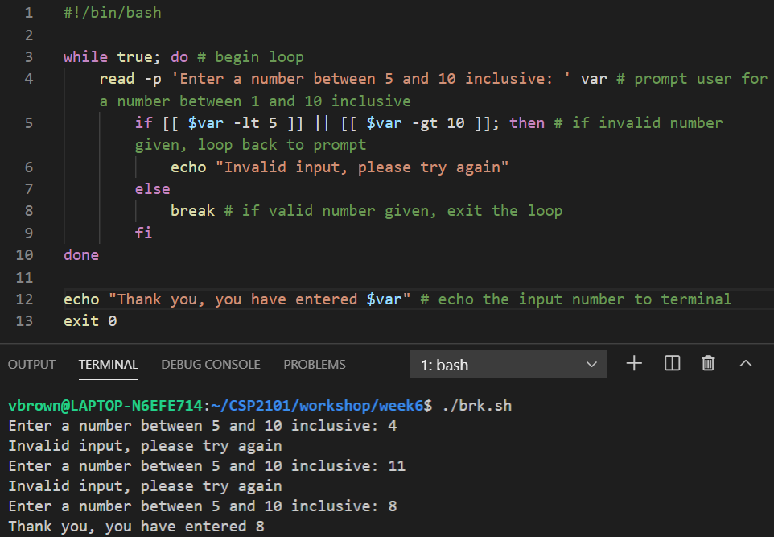
Break Example

Slide 22
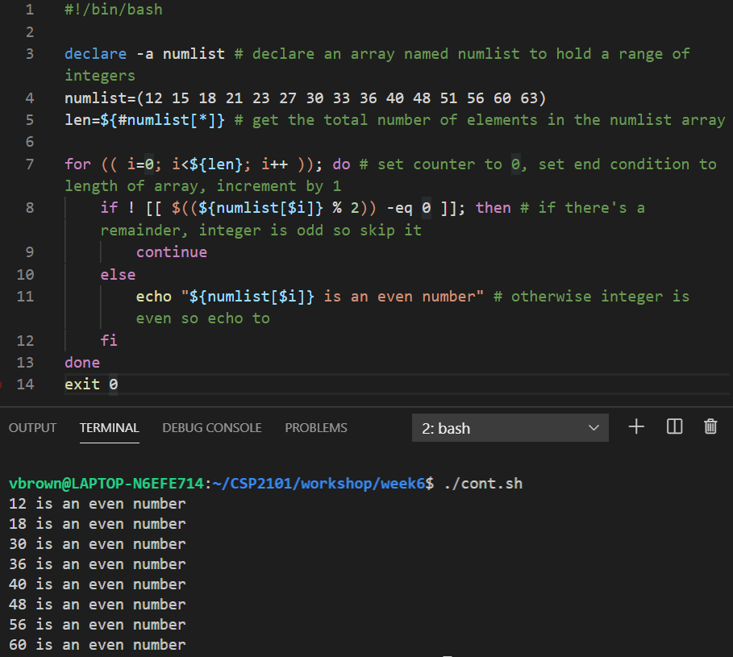
Continue Example
~/CSI6203

Slide 23
Nested Loops

Slide 24
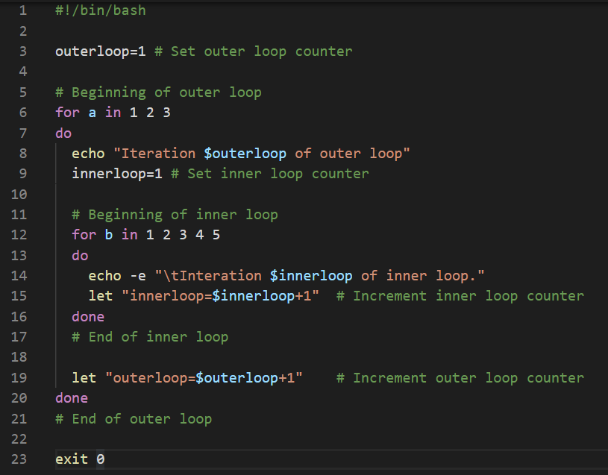
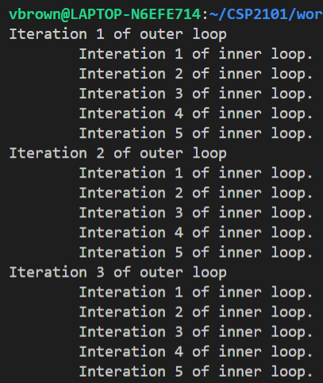
Nested loops
Loops can be placed inside each other.
The entire inner loop will be repeated by the outer loop
~/CSI6203

Slide 25
Infinte Loops

Slide 26
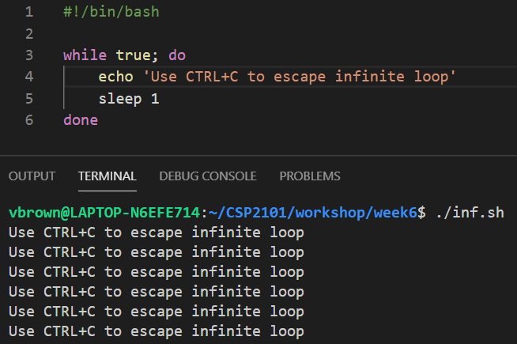
Infinite Loops
There is nothing in bash that stops you from creating loops that cannot finish.
These can be created by using a guard that:
Has a boolean expression that can never be false
Has a boolean expression that can be false but doesn’t reach that case
Has an error that causes the loop to not execute the statements within
~/CSI6203

Slide 27
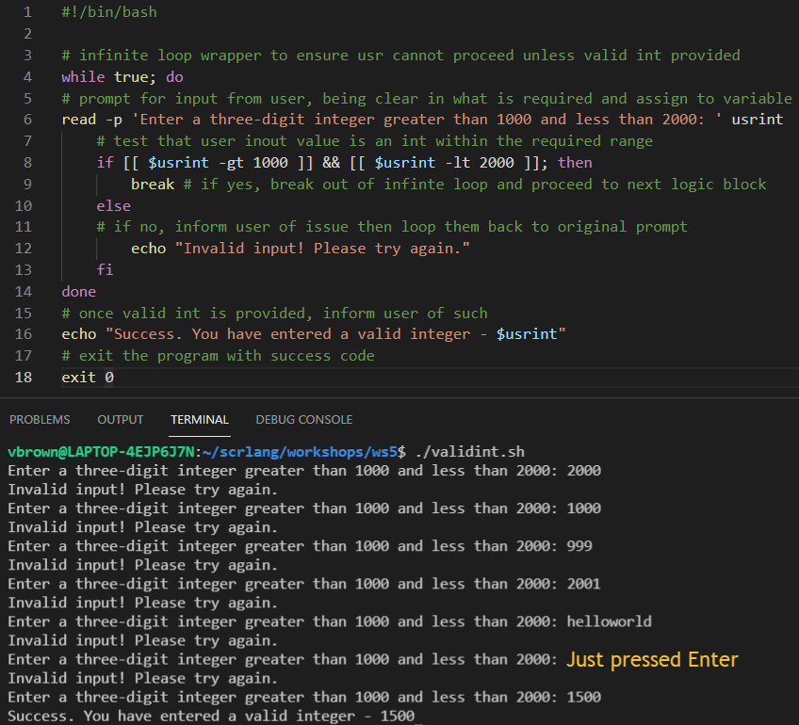
Infinite Loop Example
Write a script that when run, prompts the user to enter a three-digit integer that is > 1000 but < 2000
In this case, an infinite loop structure is used to ensure user cannot proceed until a valid input is provided
The break keyword allows the loop to be escaped when a valid value has been provided

Slide 28
References and Further Reading
Ebrahim, M. and Mallet, A. (2018) Mastering Linux Based Scripting (2nd Ed), Chapter 6, pp 102-120

Slide 29
Terms to Know
Iteration
For Loops
C-Style Loops
While Loops
Until Loops
Break and Continue
Nested Loops
Infinite Loops

Slide 30
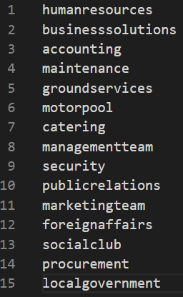
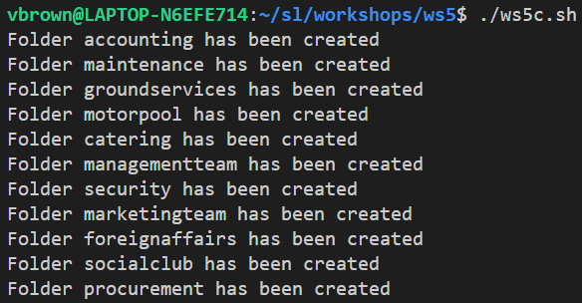
foldernames.txt (input)
ws5c.sh (output)

